Slide 2
CHAPTER 25
Architecture Competence

Slide 3
The lyf so short, the craft so long to lerne.
—Geoffrey Chaucer

Slide 4
Chapter Outline
Introduction
Architecture Competence
Duties
Skills
Knowledge
Organizational Architectural Competence
Summary

Slide 5
Introduction
Despite its technical nature, architecture also requires strong human and organizational understanding.
Most of the literature about architecture concentrates on the technical aspects. But architecture is created by humans in real-world organizations; an inherently nontechnical environment.
This chapter is about the competence of both architects and organizations.
We will first discuss architecture competence and then competence of a software architecture organization.

Slide 6
Architecture Competence
Architects perform many activities beyond directly producing an architecture.
Duties, skills, and knowledge form a triad upon which architecture competence for individuals, rests.
Knowing the duties, skills, and knowledge of architects can help establish measurement and improvement strategies for individual architects.
Steps to Improve Architectural Competence:
Gain experience carrying out the duties.
Improve your nontechnical skills.
Master the body of knowledge and remain up-to-date on it.

Slide 7
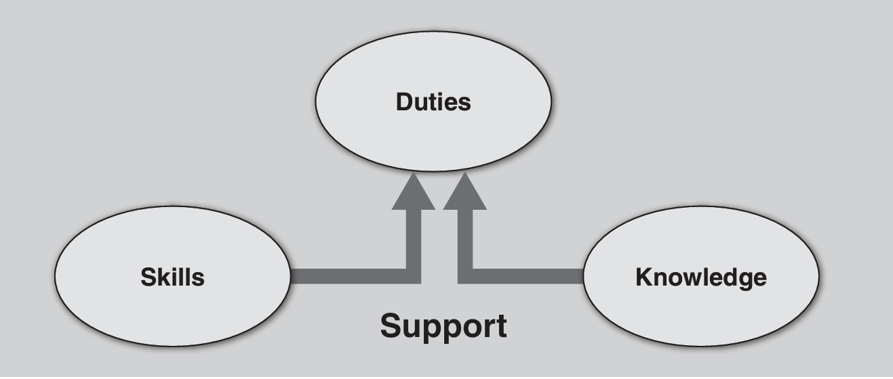
Architecture Competence
The relationship among Duties, skills, and knowledge is shown in this figure.
Skills and knowledge support the ability to perform the required duties.
Infinitely talented architects are of no use if they cannot (for whatever reason) perform the duties required of the position; we would not say they were competent.

Slide 8
Duties
We divide these duties into technical duties and nontechnical duties. Which are shown on separate tables on next slides
The number of nontechnical duties highlights the need to develop beyond technical expertise

Slide 9
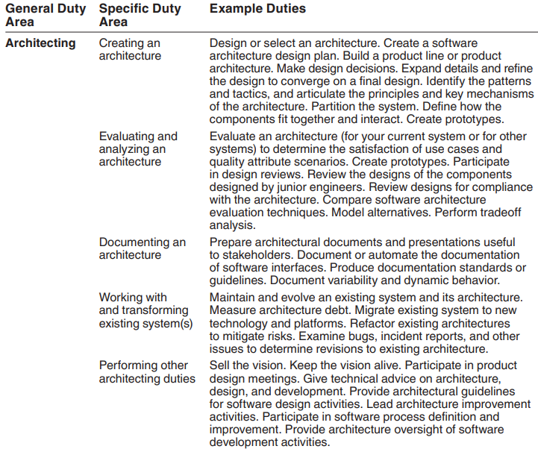
Technical Duties of a Software Architect

Slide 10
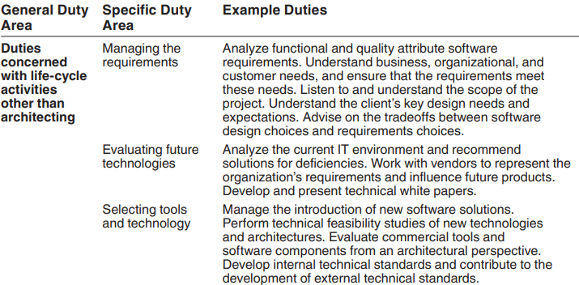
Technical Duties of a Software Architect continued

Slide 11
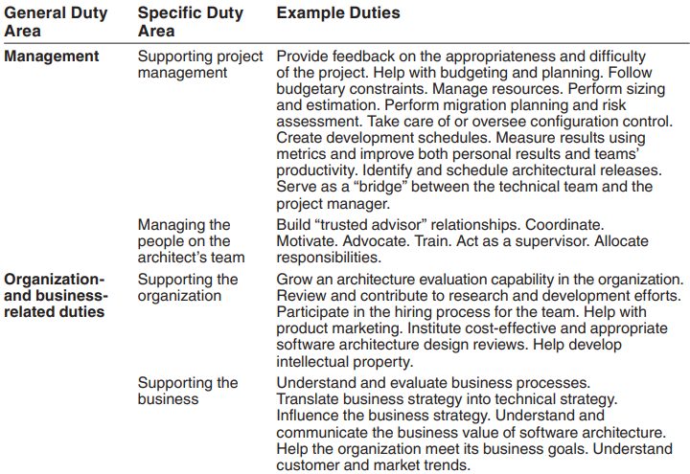
Nontechnical Duties of a Software Architect

Slide 12
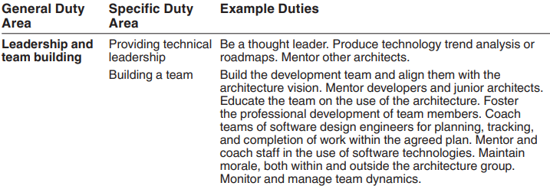
Nontechnical Duties of a Software Architect continued

Slide 13
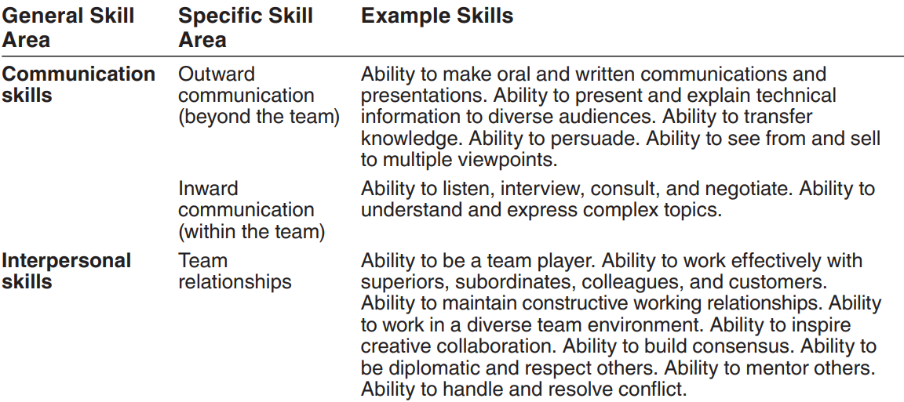
Skills
Given the wide range of duties enumerated, which skills does an architect need to possess?
Much has been written about the architect’s special role of leadership in a project.
Also some certification programs emphasize nontechnical skills.
This Table enumerates the set of skills most useful to an architect.

Slide 14
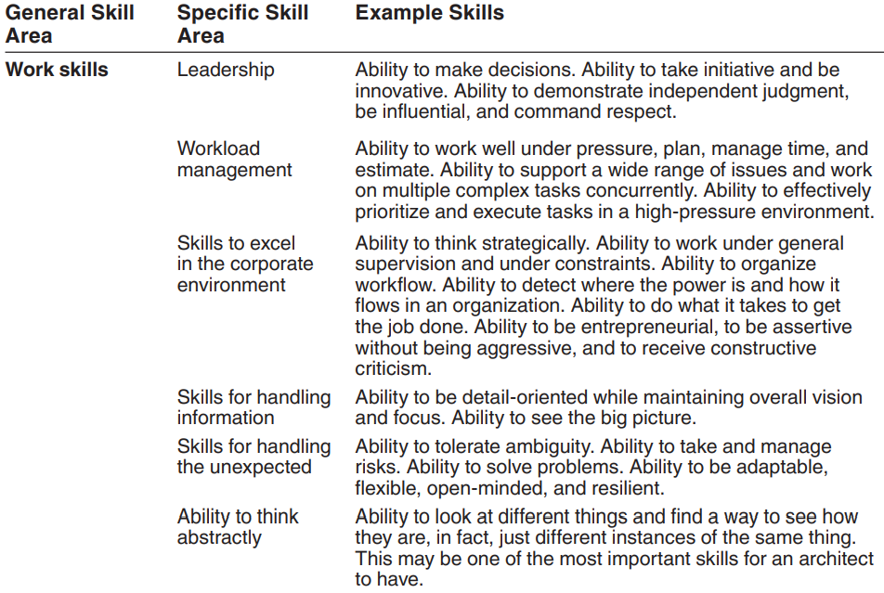
Skills of a Software Architect continued

Slide 15
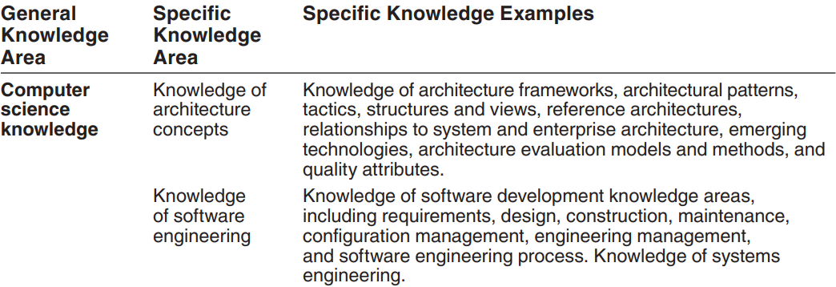
Knowledge
A competent architect has an intimate familiarity with an architectural body of knowledge.
This Table gives a set of knowledge areas for an architect.

Slide 16
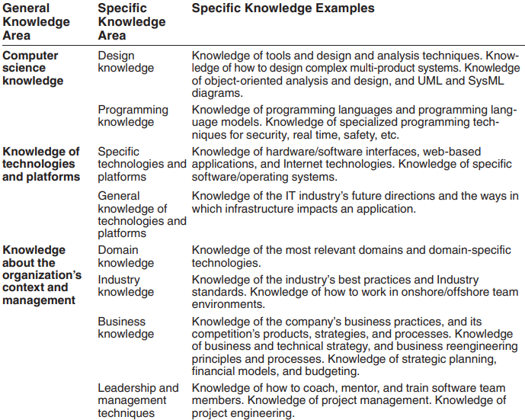
Knowledge Areas of a Software Architect continued

Slide 17
Organizational Architectural Competence
Organizations can either support or hinder software architects based on their internal practices and structure.
It makes sense, therefore, to ask whether a particular organization is architecturally competent and to develop instruments whose goal is measuring the architectural competence of an organization.
The architectural competence of an organization is the ability of that organization to grow, use, and sustain the skills and knowledge necessary to effectively carry out architecture-centric practices at the individual, team, and organizational levels to produce architectures with acceptable cost that lead to systems aligned with the organization’s business goals.

Slide 18
Organizational Architectural Competence
Organizations have duties, skills, and knowledge for architecture, just like individual architects.
These are organizational duties because they are outside the control of individual architects.
Adequately funding the architecture effort is an organizational duty.
Effective knowledge management or human resource management as applied to architects are examples of organizational skills.
An example of organizational knowledge is the composition of an architecture-based life-cycle model.

Slide 19
Organizational Architectural Competence
An organization can enhance architectural competence through thoughtful personnel policies. For example:
Hire talented architects.
Create mentoring, training, and certification programs.
Establishing strong architecture processes supports organizational competence. For example:
Set clear responsibilities and authority for architects.
Create forums and review boards for architects.
Technical infrastructure can reinforce architecture-centered practices. For example:
Maintain repositories for reusable architectures and design concepts.
Provide centralized support for architecture tools and analysis.

Slide 20
Summary
In the same way that an architecture is much more than a technical “blueprint” for a system, an architect is much more than a designer of an architecture.
This has led us to try to understand what an architect and an architecture-centric organization must do to succeed.
An architect must carry out the duties, hone the skills, and continuously acquire the knowledge necessary to be successful. The key to becoming a good and then a better architect is continuous learning, mentoring, and being mentored.

